Slide 1


Smart Mobility Engineering Lab
(ISE3231)
Week _ Lecture
ISE Department Prof. Mehdi Pirahandeh
School of Global Convergence Studies

Slide 2

Intruder Detection and
Video Feedback while Navigating
1
School of Global Convergence Studies

Slide 3
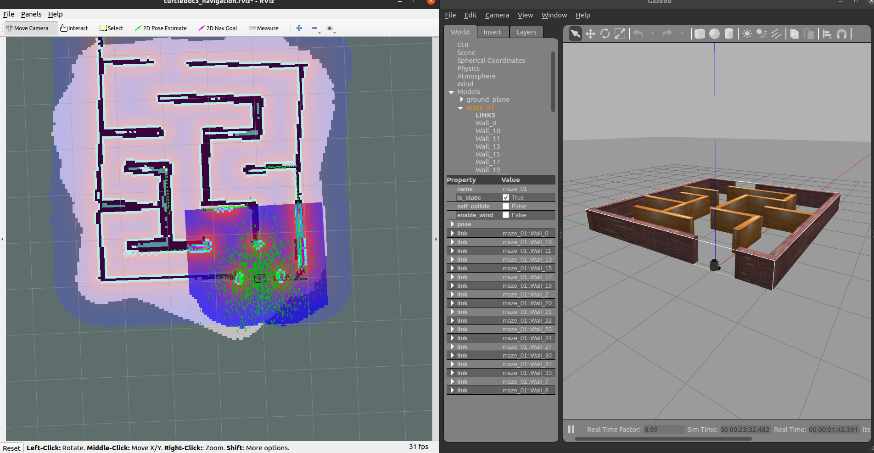
Go-to-Goal Behavior
School of Global Convergence Studies
Notes:
Launch the previous custom environment
Try to navigate the robot by using ‘2D Nav Goal’

Slide 4
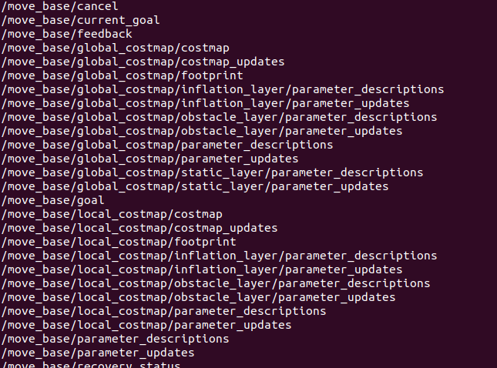
Go-to-Goal Behavior
School of Global Convergence Studies
Notes:
Open a new terminal
Check the list of `rostopic`
And notice that we have ‘move_base/goal’ topic

Slide 5
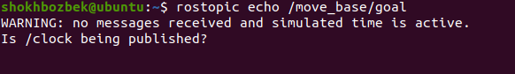
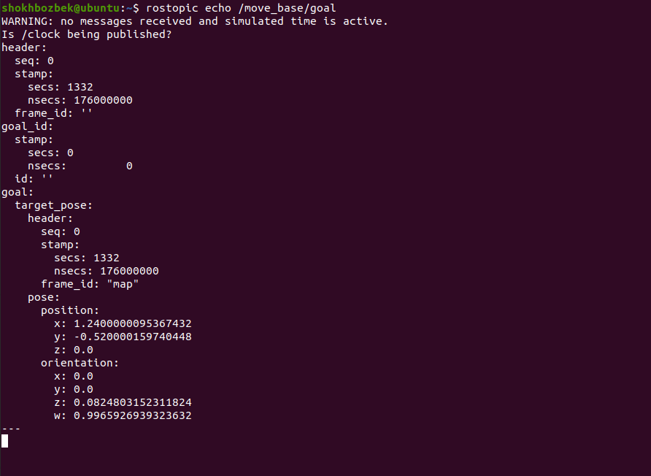
Go-to-Goal Behavior
School of Global Convergence Studies
Notes:
Now we check what is the message from ‘move_base/goal’
Initially there will not be any message output unless we navigate the robot
Back to the ‘RVIZ’ and try to navigate the robot again and see the message
In the message you can see the position of clicked point

Slide 6
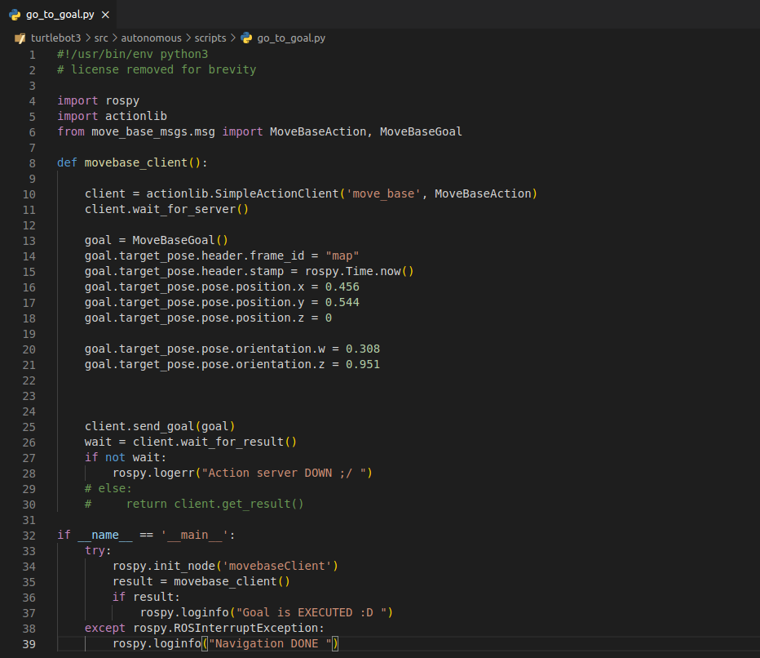
Go-to-Goal Behavior
Open a new terminal, go to the ‘scripts’ folder and execute the command
School of Global Convergence Studies
Notes:
Create a new python script to the ‘[project_ws]/src/autonomous/scripts’ folder and paste the following code which navigate the robot to the specific position
The file must be executable so do the following command

Slide 7
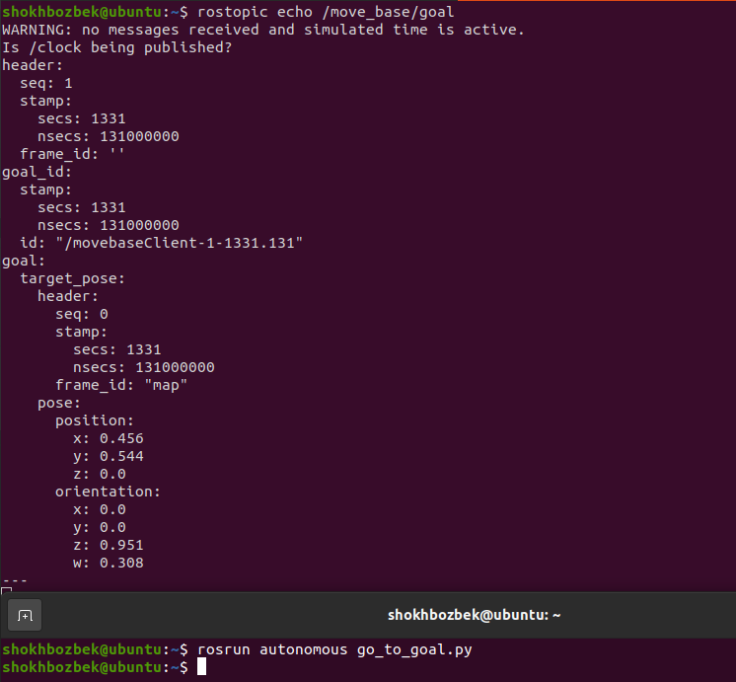
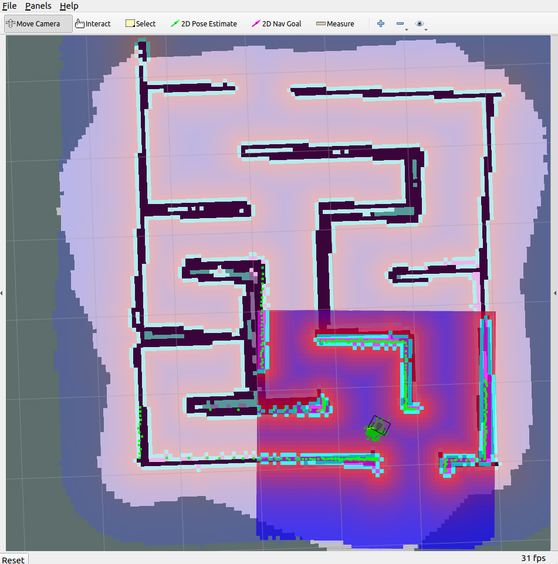
Go-to-Goal Behavior
School of Global Convergence Studies
Notes:
Open a new terminal and run the script
After execution, the goal position is received and you can see the given position in the message of ‘/move_base/goal’
Then the robot starts moving toward the goal

Slide 8
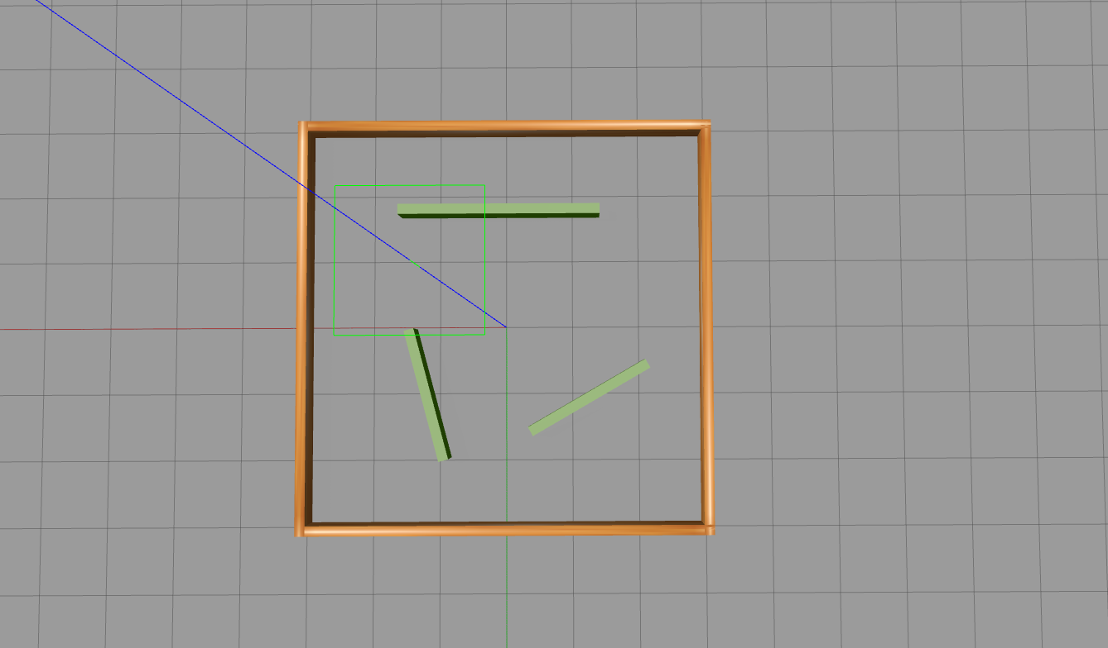
Creating a New Simulation World
School of Global Convergence Studies
Notes:
Try to create a new closed simulation world (a simple room)

Slide 9
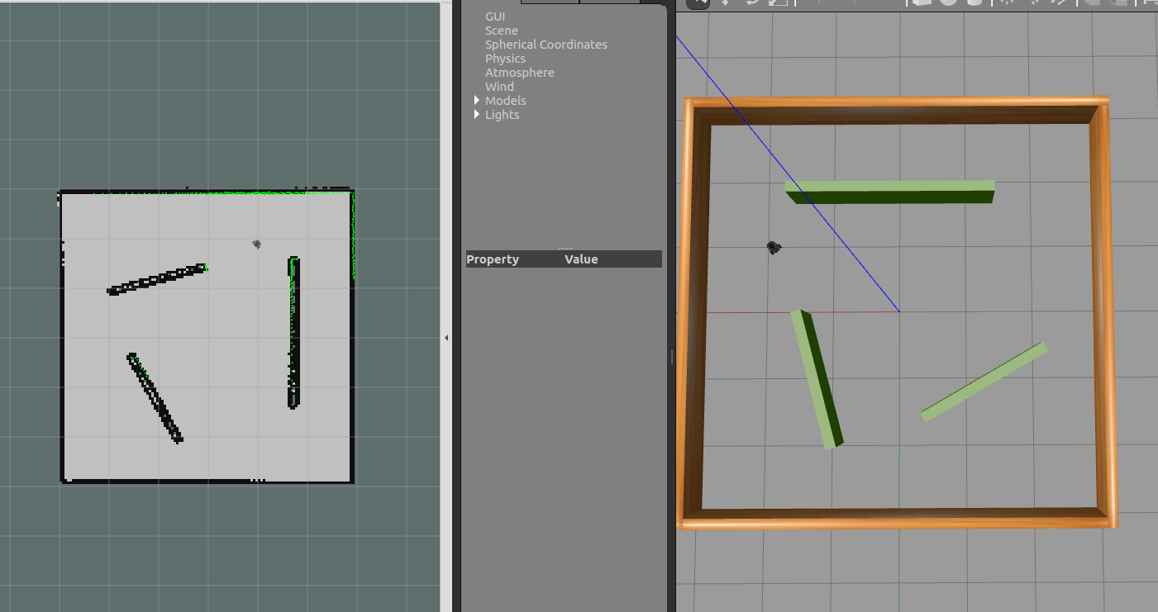
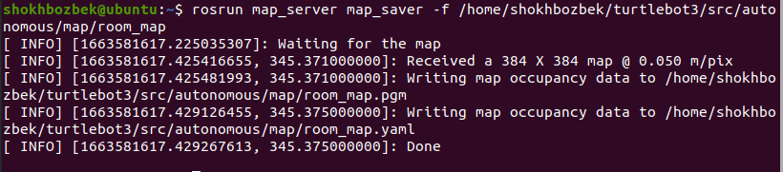
Slam and Save the Map
Open a new terminal and save the map
School of Global Convergence Studies

Slide 10
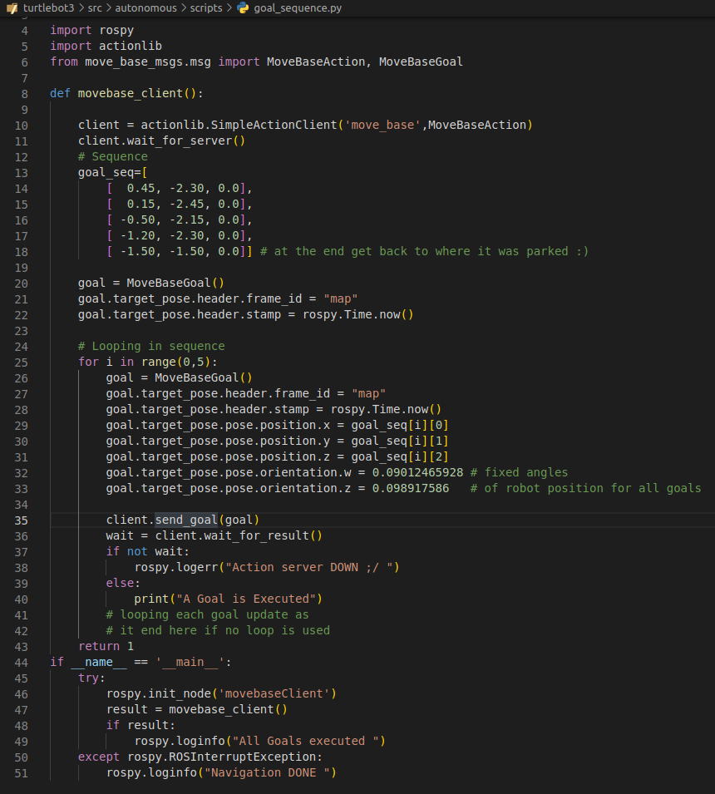

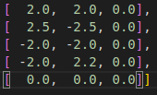
Go-to-Goal Sequence
Open a new terminal, go to the ‘scripts’ folder and execute the command
School of Global Convergence Studies
Notes:
Paste the script and as you can see there are several position sequences and last position where the robot starts
Make the new script executable

Slide 11
Go-to-Goal Sequence
Open a new terminal, execute the command
School of Global Convergence Studies
Notes:
This will launch the ‘room’ environment and then the robot starts to go to goals as given in sequence

Slide 12
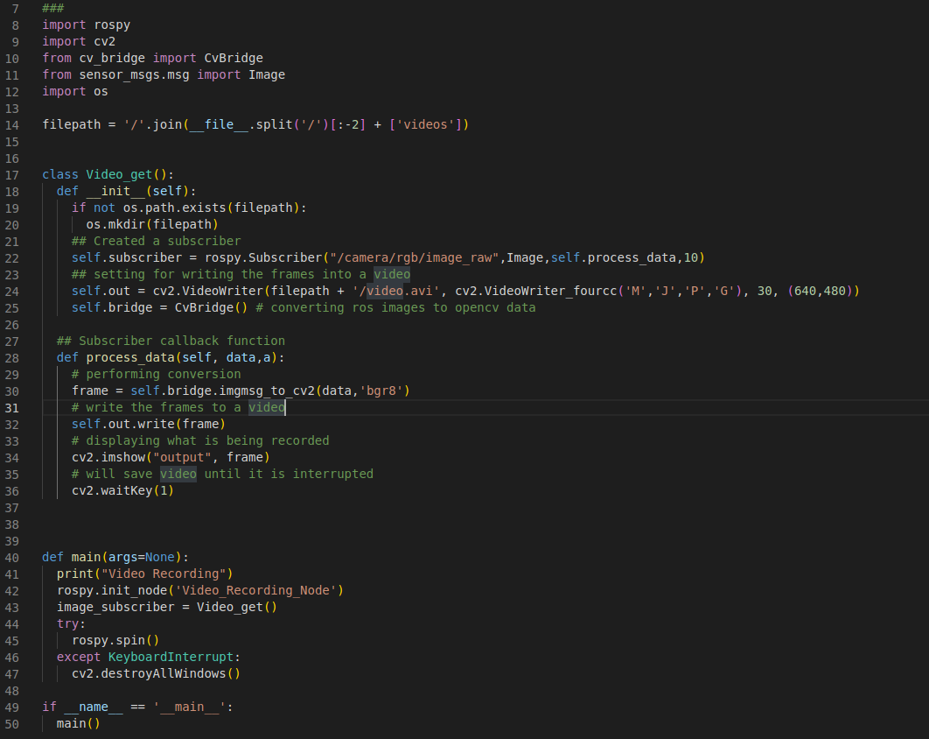
Video Recorder
video_recorder.py
School of Global Convergence Studies

Slide 13
Video Recorder
Open a new terminal, start video recorder
Open a new terminal, start going sequenced goals
School of Global Convergence Studies
Notes:
Launch the environment
Open a new tab and start video recorder
Then open a new tab and run the sequence goal

Slide 14

Video Recorder
School of Global Convergence Studies

